Slide 1
Power distribution

Slide 2
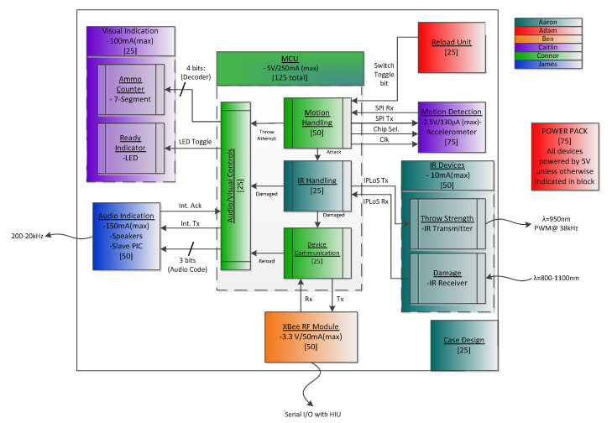
Total maximum current
= (100+150+250+.13+10+50)mA
= 560.13mA

Slide 3
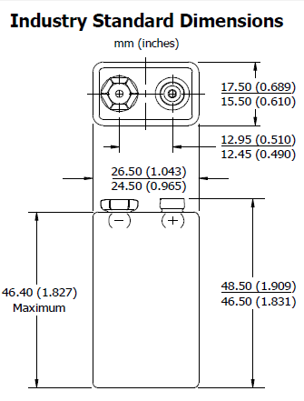
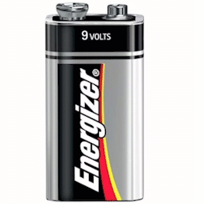
Battery research for 9v
Typical Weight
45.6 grams
*Image taken from http://alkalinebatteries.us/Energizer_9Volt_522.html
*Image taken from
http://data.energizer.com/PDFs/EN22.pdf
Chemistry | Battery number | Capacity at a 500mA discharge rate | Datasheet site
Alkaline | EN22 | 300mAH | http://data.energizer.com/PDFs/EN22.pdf
Alkaline | 522 | 300mAH | http://data.energizer.com/PDFs/522.pdf
Carbon Zinc | 1222 | N/A | http://data.energizer.com/PDFs/1222.pdf
Lithium | LA522 | 600mAH | http://data.energizer.com/PDFs/la522.pdf
Rechargeable | NH22-17 | N/A | http://data.energizer.com/PDFs/nh22-175.pdf

Slide 4
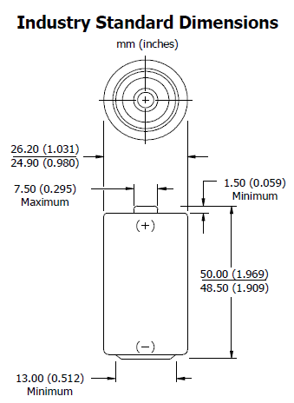
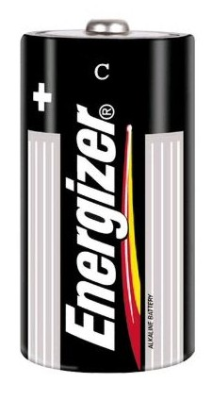
Battery research for C-cell 1.5V
Typical Weight
66.2 grams
*Image taken from
http://data.energizer.com/PDFs/EN93.pdf
*Image taken from
http://www.blasterstool.com/energizerbatteryc-cellen932pack.aspx
Chemistry | Battery number | Capacity at a 500mA discharge rate | Datasheet site
Alkaline | EN93 | 5000mAh | http://data.energizer.com/PDFs/EN93.pdf
Alkaline | E93 | 5000mAh | http://data.energizer.com/PDFs/E93.pdf
Alkaline | 3-335 | 5000mAh | http://data.energizer.com/PDFs/3-335i.pdf
Alkaline | 3-335NNC | 5000mAh | http://data.energizer.com/PDFs/3-335nnci.pdf
Carbon Zinc | 1235 | 5000mAh | http://data.energizer.com/PDFs/1235.pdf
Rechargeable | NH35-250 | 2500mAh | http://data.energizer.com/PDFs/nh35-2500.pdf

Slide 5
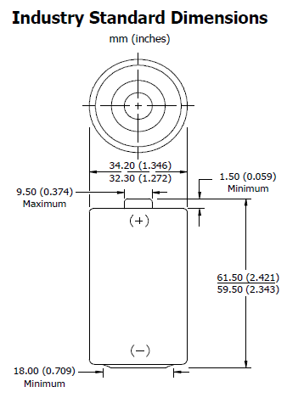
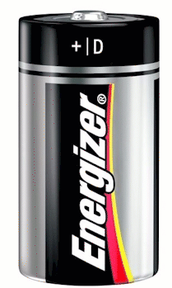
Battery research for D-cell 1.5V
Typical Weight
148.0 grams
*Image taken from
http://data.energizer.com/PDFs/EN95.pdf
*Image taken from
http://www.electronicsnmore.com/index.php/cPath/4_92_88
Chemistry | Battery number | Capacity at a 500mA discharge rate | Datasheet site
Alkaline | EN95 | 8000mAh | http://data.energizer.com/PDFs/EN95.pdf
Alkaline | E95 | 8000mAh | http://data.energizer.com/PDFs/E95.pdf
Alkaline | 3-350 | 8000mAh | http://data.energizer.com/PDFs/3-350i.pdf
Alkaline | 3-350IW | 8000mAh | http://data.energizer.com/PDFs/3-350iwc.pdf
Alkaline | 3-350NNC | 8000mAh | http://data.energizer.com/PDFs/3-350nnci.pdf
Alkaline | 3-350W | 8000mAh | http://data.energizer.com/PDFs/3-350wc.pdf
Alkaline | A9 | N/A | http://data.energizer.com/PDFs/A95.pdf
Carbon Zinc | 1250 | 5500mAh | http://data.energizer.com/PDFs/1250.pdf
Rechargeable | NH50-250 | 2500mAh | http://data.energizer.com/PDFs/NH50-2500.pdf

Slide 6
Advantages/disadvantages
Battery | Advantages | Disadvantages
9V | High supply voltage | Very low overall efficiency Low efficiency per weight (7mA/gram)
C-cell | Maximum efficiency per weight (75mA/gram) | Low supply voltage
D-cell | High efficiency | Low supply voltage Heavy Low efficiency per weight (54mA/gram)

Slide 7
The winner?
C-cell non-rechargeable battery!!
With 6 batteries in series, power supply time will be 6+ hours.
Total weight of C-cell batteries will be 397g(14oz)
Same number of D-cell batteries would be 888g(31oz)
16 9v batteries would be needed to provide same amount of battery capacity which would be 730g(26oz)

Slide 8
The winner?
C-cell non-rechargeable battery!!
Size of battery pack will be approximately 6”x2”x1” (WxLxH)
Approximate cost of battery pack will be $12.50
*Price of batteries were found at http://www.amazon.com/Energizer-Alkaline-Size-Battery-8-Count/dp/B0044DA3NS/ref=sr_1_1?ie=UTF8&qid=1318388169&sr=8-1

Slide 9
MAXIMUM CURRENT/VOLTAGE DIVISION
Total maximum current
= (100+150+250+.13+10+50)mA
= 560.13mA
3.3V maximum current consumption
= 50.13mA
5V maximum current consumption
= 510mA

Slide 10
Voltage regulators
LDO regulator vs Standard regulator
Voltage drop required to maintain output voltage regulation
LDO requires least voltage
Standard requires the most

